Slide 1
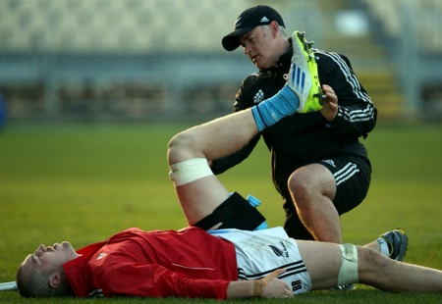
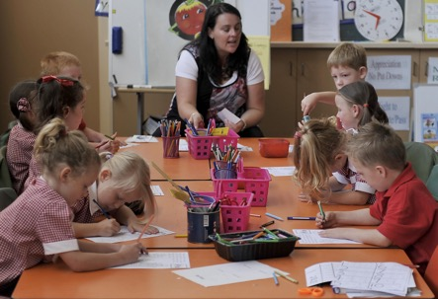

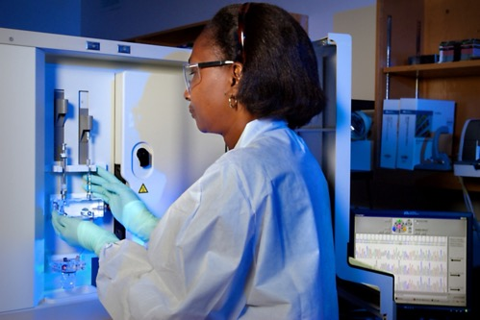
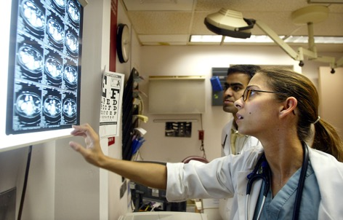
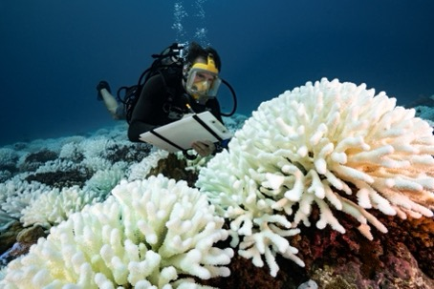
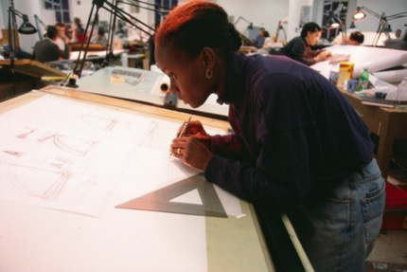

Visual Art and your future

Slide 2
Visual Art and your future
have you thought about the career you might pursue after school?
“employers are not only signalling demand for creativity, critical thinking, problem solving and skills relating to the development and use of technology, but are placing more and more emphasis on interpersonal and socio-emotional skills. The latter include the ability to collaborate, coordinate and communicate effectively with others”
Reference: The World Economic Forum, 2023, Defining Education 4.0: A Taxonomy for the Future of Learning. Source https://www3.weforum.org/docs/WEF_Defining_Education_4.0_2023.pdf

Slide 3
Visual Art and your future
How might studying Visual Art develop these future employability skills?
creativity
critical thinking
problem solving
skills relating to the development
and use of technology
collaboration
communication

Slide 4
Visual Art and your future
Read the testimonies of past Visual Art students. How do you think Visual Art developed future employability skills?
Why is it important to learn skills that will assist life-long learning?

Slide 5
Visual Art and your future
“While there are repeating forms within my practice (Dilly bags) it is the material they are made of and the process of deconstruction and reconstruction which give them their meaning. In this way, I feel like I am presenting a translated book which you are able to ‘read’ in a new way, as opposed to a functional Dilly Bag which could be used in its traditional way.”
JENNA LEE
Jenna Lee is a Gulumerridjin (Larrakia), Wardaman and KarraJarri Saltwater woman with mixed Japanese, Chinese, Filipino and Anglo-Australian ancestry
How is Lee’s Their Words Vol.2 an expression of 21st century skills and ideas for both artist and audience?
Jenna Lee, Their Words Vol.2, 2022, pages of ‘Aboriginal words and Place names’, varnish, garramal-wa (Gulumerridjin white ochre).
Courtesy of the artist and MARS Gallery

